Slide 1
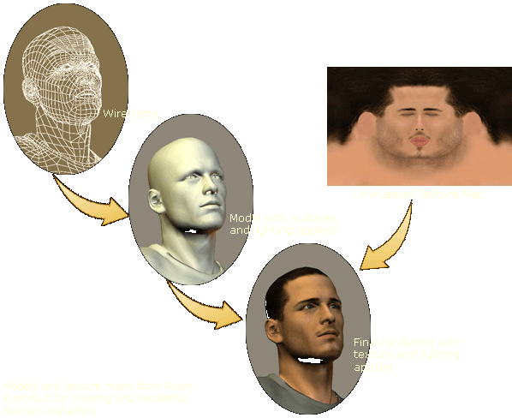
Computer Graphics
Texture Mapping

Slide 2
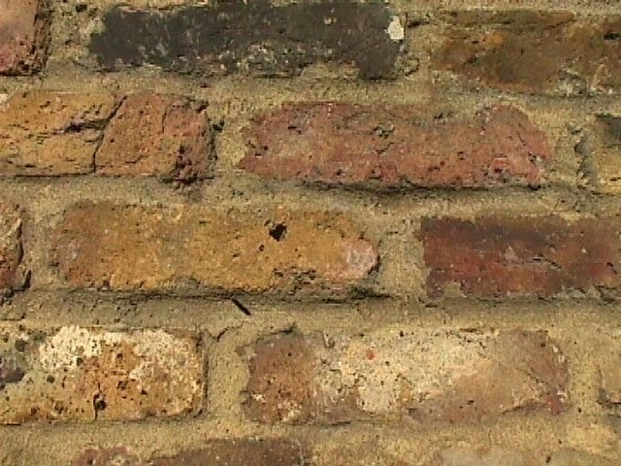
Introduction and Motivation
so far: detail done with polygons & materials
problem:
many polygons & materials needed to show detailed structures
inefficient for memory and processing
new approach: texture mapping

Slide 3
Introduction and Motivation
several properties can be modified
color: diffuse component (k_{d})
reflection: specular component of surface (k_{s}) normal vector: simulate 3D surface structure (bump mapping)
actual surface: raise/lower points to actually modify surface (displacement mapping)
transparency: make parts of a surface entirely or to a certain degree transparent

Slide 4
Texture Mapping
texture: 2D color (RGB) pixel image
texel: one pixel in a texture
models the ‘appearance’ of a surface
procedure to map the texture onto the (polygonal) surface needed
goal: find easy way to do this mapping

Slide 5
Texture Mapping
rendering pipeline: slightly modified to use texture mapping
algorithm: for each pixel to be rendered
find depicted polygon point p
find point in texture (texel) T that corresponds to surface point p
use color of T to modify the shading of p

Slide 6
Texture Mapping: Definitions
2D texture:
function from points on 2D (u, v) plane to (r, g, b) values: (r, g, b) = c_{tex}(u, v)
texture mapping function F_{map} maps (u, v) values to (x, y, z) positions on objects: (x, y, z) = F_{map} (u, v)
we need the inverse function: find (u, v) values for a (x, y, z) position: (u, v) = F_{map}⁻¹ (x, y, z)

Slide 7
Texture Mapping: General Procedure
general texture mapping pipeline:
Once we have a texel color T=(t_{R},t_{G},t_{B}) at a 3D point (x,y,z)
use T as components (k_{R},k_{G},k_{B}) in the Phong illumination model (see previous module)
(x,y)
(x,y,z)
(u,v)
(s,t)
determine surface position
find texture coordinates
find corres- ponding texel
possibly more processing
modify illumination
(s,t)
(r,g,b)
(r,g,b)

Slide 8
u,v-Coordinates: Projector Functions
goal: derive texture coordinates (u,v) from 3D point (x,y,z)
P: ℜ³ → ℜ², so P(x, y, z) = (u, v)
several possibilities
(manual) surface parameterization
two-step technique

Slide 9
(Manual) Surface Parameterization
simplest technique
specify texture coordinates (u,v) during modeling, for all polygon vertices
linearly interpolate these values for points inside a polygon
can be done in graphics hardware, just like color or Z (depth) interpolation

Slide 13
Two Step Approach
problem with manual technique:
too tedious (manual parameterization)
new idea:
texture mapped on simple intermediate 3D surface that has inherent coordinates
transfer mapping onto any complex object
common intermediate surfaces:
cylinder, sphere, plane, box

Slide 14
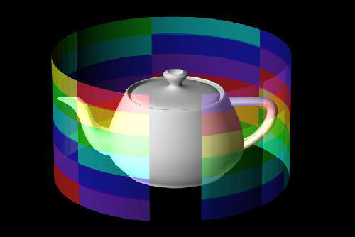
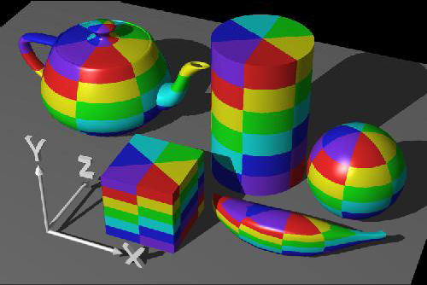
Cylindrical Mapping
map to cylinder surface: use height h₀ and angle θ₀
using scaling factors c, d, and the radius r
discontinuity along a line parallel to center axis of symmetry…

Slide 15
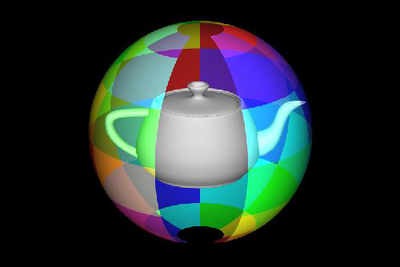
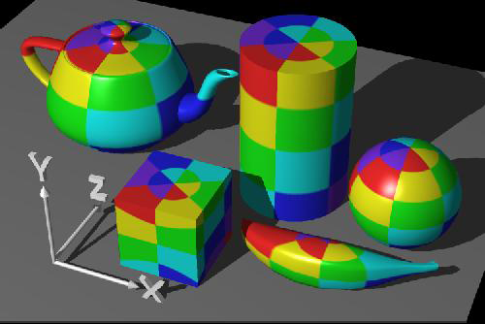
Spherical Mapping
map to surface of a sphere: use spherical coordinates
no non-distorting mapping possible between plane and sphere surface

Slide 16
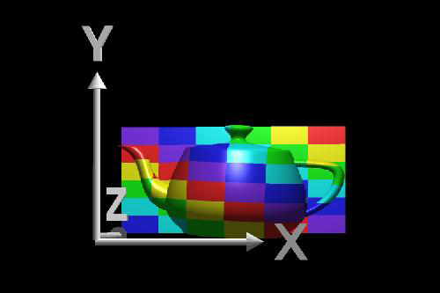
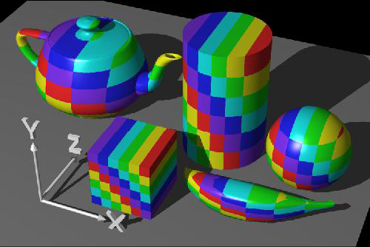
Planar Mapping
map to planar surface: use position vector v₀ and two vectors s and t
scaling factor k and v = P_{i} – v₀ (gives point position w.r.t. plane origin)

Slide 17
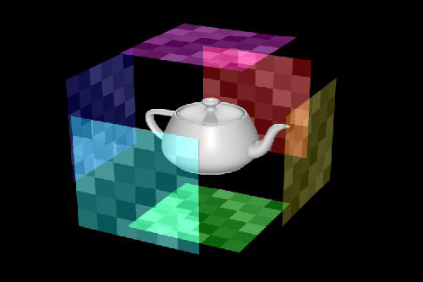
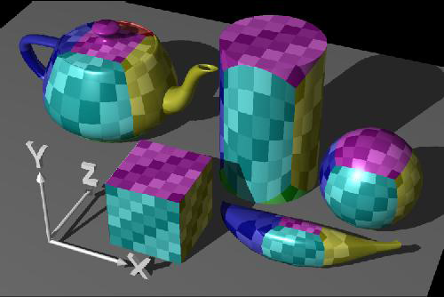
Box Mapping
enclosing box: usually axis-parallel bounding box of object
map texture to six rectangles

Slide 18
Correspondence Functions
projector functions P yield (u, v) coordinates in texture parameter space
typical values of u and v in [0, 1]
problem: what happens outside of [0,1]?
typical approaches
texture repetition (tiling) using modulo function
texture mirroring: better continuity at texture seams
clamping: repeat the last value of the texture edges for values outside of [0, 1]
border color: use a specified color for all values (u,v) outside [0,1]

Slide 19
Using Texture Values
from an (x, y, z) 3D position, we derived an (r, g, b) texture color value
use this value as follows:
replace: surface color value (k_{R},k_{G},k_{B}) is replaced with texture color (r,g,b)
modulate: multiplication of surface color value (k_{R},k_{G},k_{B}) with texture color (r,g,b)

Slide 20
Texture Mapping
Quality Considerations

Slide 21
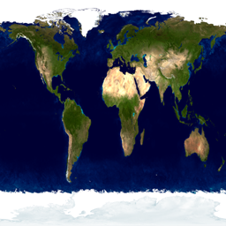



Texture Mapping: Mip Mapping
optimal texture mapping (speed & quality):
texel size ≈ pixel size
idea:
use stack of textures
select the best fitting one w.r.t. polygon size
64 × 64
…
1 × 1
128 × 128
256 × 256

Slide 22

Texture Mapping: Mip Mapping
implementation in OpenGL:
interpolation: GL_NEAREST_MIPMAP_NEAREST
select nearest mipmap level, select nearest pixel of 2×2 neighbourhood

Slide 23

Texture Mapping: Mip Mapping
implementation in OpenGL:
interpolation: GL_LINEAR_MIPMAP_NEAREST
select nearest mipmap level, linearly interpolate pixel in 2×2 neighbourhood

Slide 24


Texture Mapping: Mip Mapping
implementation in OpenGL:
interpolation: GL_NEAREST_MIPMAP_LINEAR
select 2 adjacent mipmap levels, select nearest pixel in 2×2 neighbourhoods,
then interpolate between them

Slide 25

Texture Mapping: Mip Mapping
implementation in OpenGL:
interpolation: GL_LINEAR_MIPMAP_LINEAR
select 2 adjacent mipmap levels, linearly interpolate pixel in 2×2 neighbourhoods,
then interpolate between them

